Slide 1
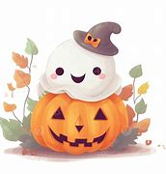
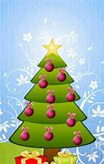
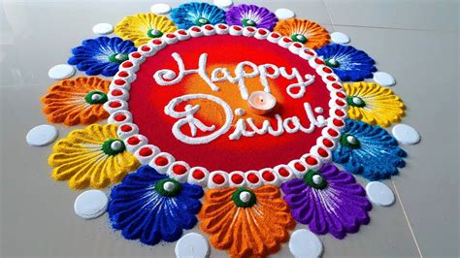
Understanding the World
This half term we will be…
Talking about the different special occasions that people might enjoy celebrating.Birthday parties that they have might attended and their plans for Halloween. They will be introduced to the expression of celebration and will make a list of different celebrations that they know of. We will be talking about different religions and how those celebrations links to them.
Physical Development
We will be learning to ….
Begin to show accuracy and care when drawing.
Use a range of small tools.
Expressive Arts and Design
This half term we will be …….
Using pictures, interests and
experiences to inspire their creations.
Exploring and creating using a wide range of materials and components, including upcycled materials.
Creating collaboratively, sharing ideas and using a variety of resources to make products.
What do you enjoy celebrating?
Personal, Social and Emotional
Development
This half term we will be…
Using technology safely and respectfully
with support from adults.
Explaining the reasons for rules, knowing
right from wrong and trying to behave
accordingly.
Communication and Language
This half term we will be…..
Articulating their ideas and thoughts in
well-formed sentences and describe events using
some detail.
Listening carefully in a range of situations and
being aware of the importance of listening.
Literacy- Reading and Writing
In phonics we will be learning the remaining sounds in set 1 of
Read, Write, Inc. We will be learning how to identify these sounds in words as well as blending and segmenting these sounds into simple CVC words. We will focus on continuing to hold our pencil using the correct tripod grip and write our letters using pre-cursive formations. We will be rehearsing our skills through reading books and using writing to communicate thoughts, ideas, experiences and events.
Mathematics- Numbers and Shape, Space and Measures
We will be exploring numbers to 5, learning how to represent, compare and compose each number (including one more and one less). We will also be learning to subitise these numbers. We will be continuing to explore circles, triangles and four-sided shapes, using these to make other shapes.

Slide 2
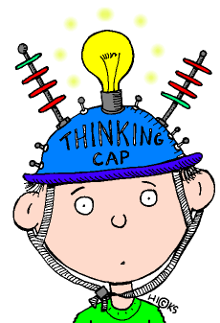
What do you enjoy celebrating?
Key Vocabulary- Phonics
Blending- to pull together individual sounds or
syllables within words.
Segmenting- breaking words down into individual
sounds or syllables.
Phoneme- The smallest unit of sound. A sound a
letter makes.
Grapheme- a way of writing down a phoneme.
Home Learning Challenges
Select from the list below the activities that you would like to do as your home learning
challenges. You can present your challenges in any way. Have fun and be creative.
Get to know a tree:
Find a big tree and give it a cuddle. Look at the patterns of its leaves and trunk. Find out its name.
Twinkle, twinkle:
Use a sparkles candle with adult supervision and draw different shapes in the air.
.
Key Vocabulary- Maths
Numeral- a symbol , 1, 2, 3 or a word one, two, three that stands for a number.
Hidden numbers – numbers that can be combined together to make the total of the focus number, ie: 5 = 2+3, 4+1.
Subitising- to look at a group of objects and realise how many there are without counting.
Jack and Jill:
Roll down a really big hill.
Did you know?
Find out one new fact about Diwali.
Terrific Tablet
Use a tablet or computer.
Can you create your own
piece of art using new
software?
Friendly Fingers
Make some finger puppets
and act out your own
show.
Topic words: Celebration
Parliament, Guy Folks, Bonfire
Remembrance, Poppy,
Wreath, War, Soldier
Jesus, Wise man, angels, stable, manger, frankincense, myrrh, gold
Menorah, dreidel, latkes, temple, Hebrew, kappa, Torah
Supporting learning at home:
Daily reading
Sound sheets- rehearsing letter formation
http://www.bbc.co.uk/schools/scienceclips/ages/5_6/science_5_6.shtml
http://www.phonicsplay.co.uk/ Phase 2 – game “Obb and Bob”
Cbeebies- Number blocks & Alpha blocks
Please keep PE kits in school. They will be returned at the end of each half term for washing.

